Slide 1
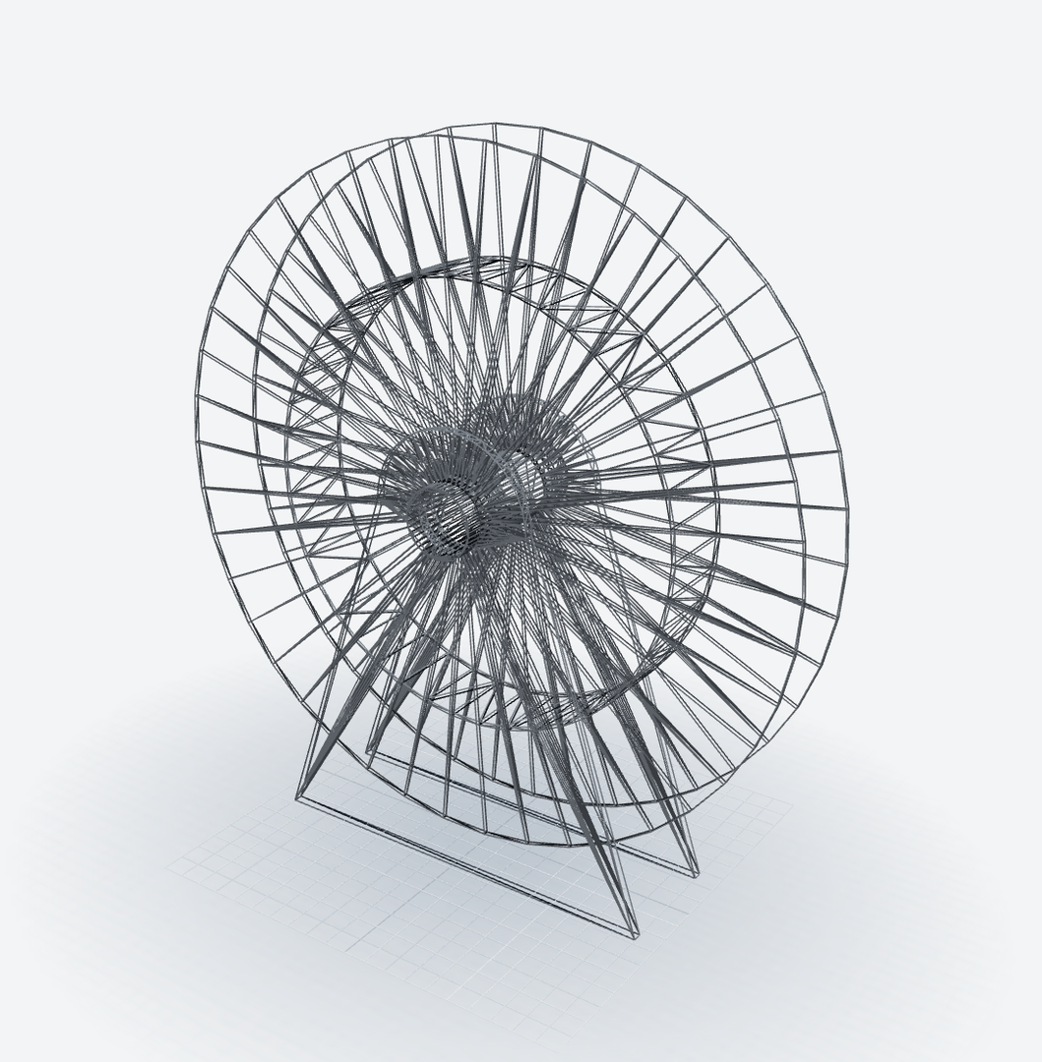

Solaris Marine – Invictus CAD
SOLARIS MARINE
Invictus CAD, in partnership with Solaris Marine.
Describe a marine part.
Get the model, the drawing
and the mass.
Engineering and design for marine hose systems
solarismarine.co.uk

Slide 2
Weeks of engineering per enquiry
THE PROBLEM
A marine hose system is engineered from scratch for each enquiry, one step at a time.
1
2
3
4
5
6
Read the enquiry
Sizes, pressure, lengths and fluid, retyped by hand
Choose the hose
Catalogue hoses checked for bore and pressure
Size the reel
Drum, core, layers and wraps from the workbook
Flotation and string
Collars, vessel stand-off and layout length
Drawings and mass
GA drawings and masses drawn up in CAD
The quote
Every number carried into the documents
Change one number, and the chain starts again.
Each step sits in its own spreadsheet or CAD file, and each one has to be checked again by hand.
Solaris Marine – Invictus CAD
2

Slide 3
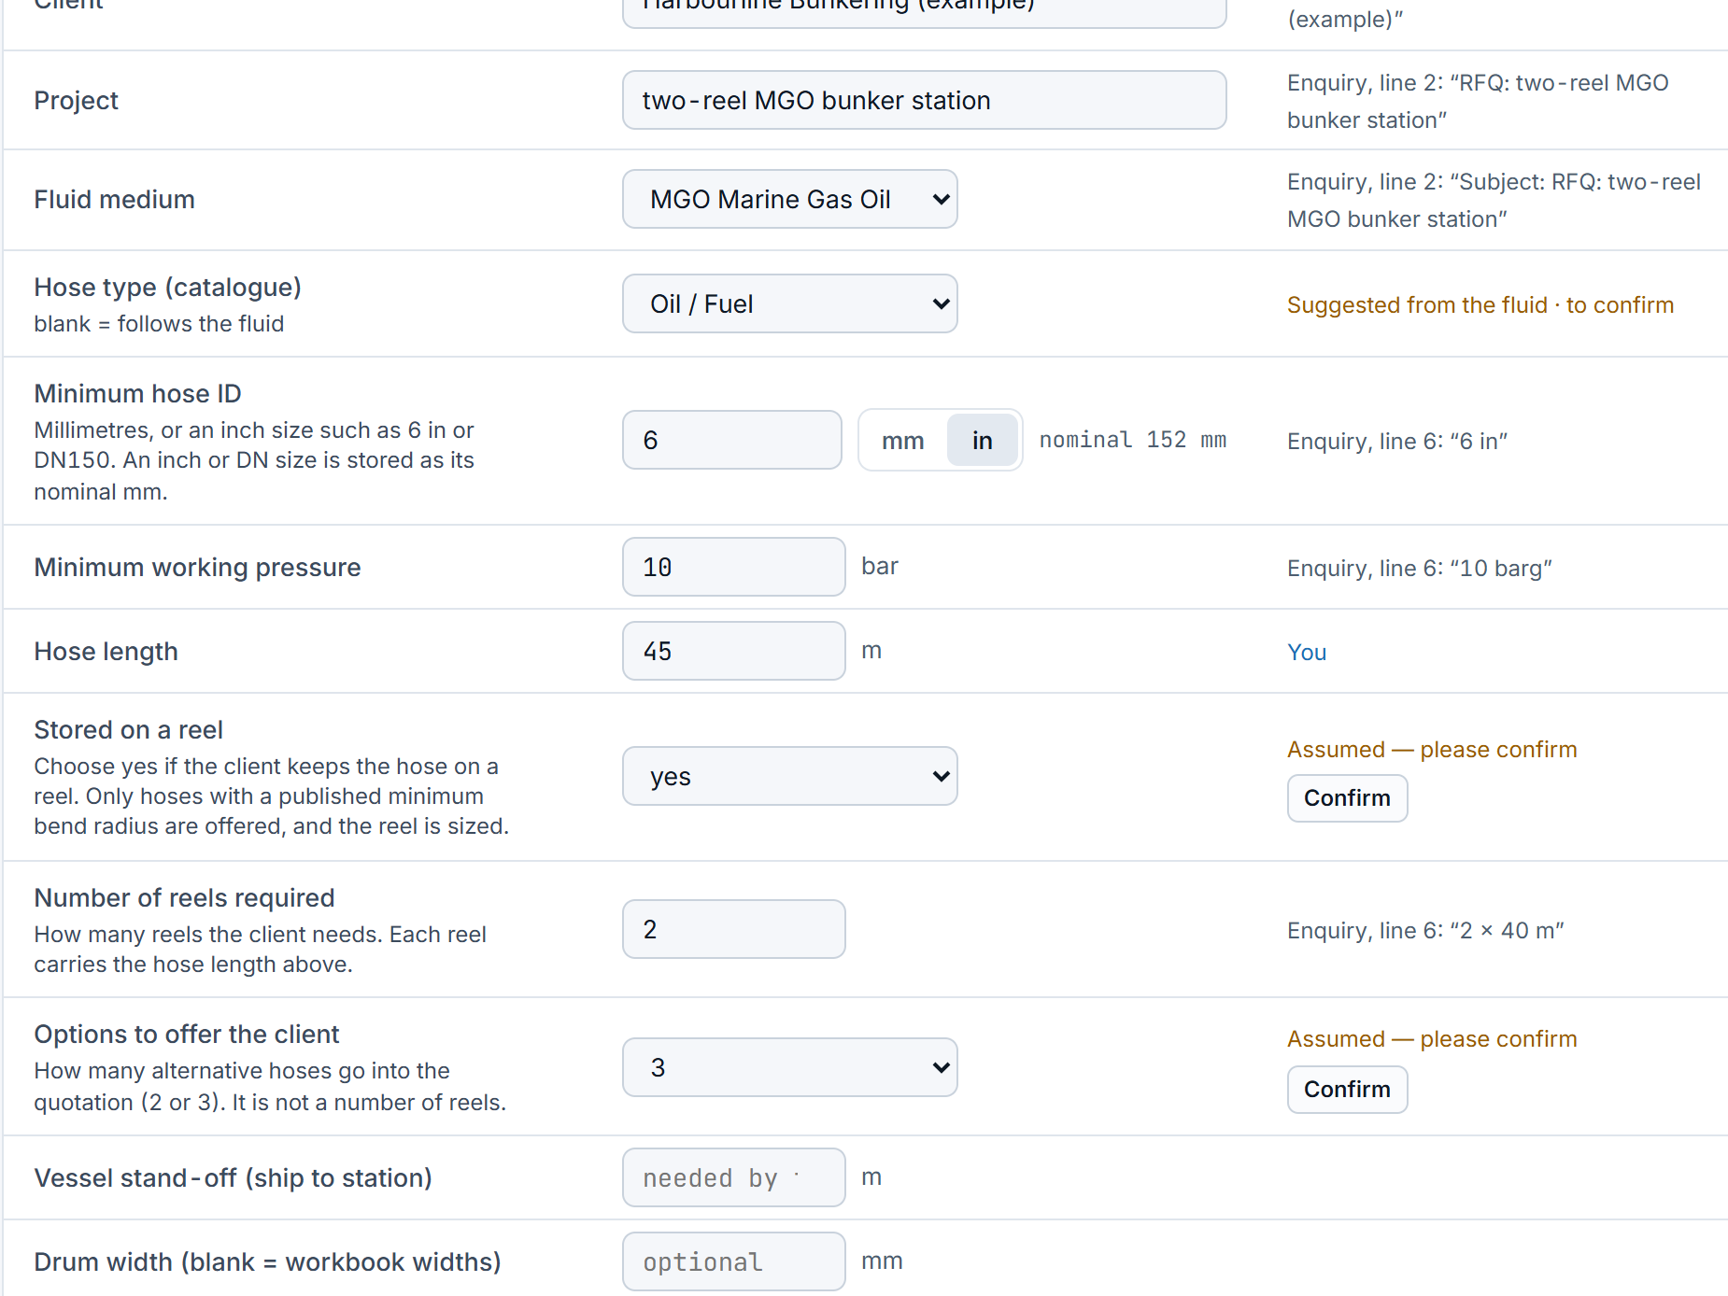
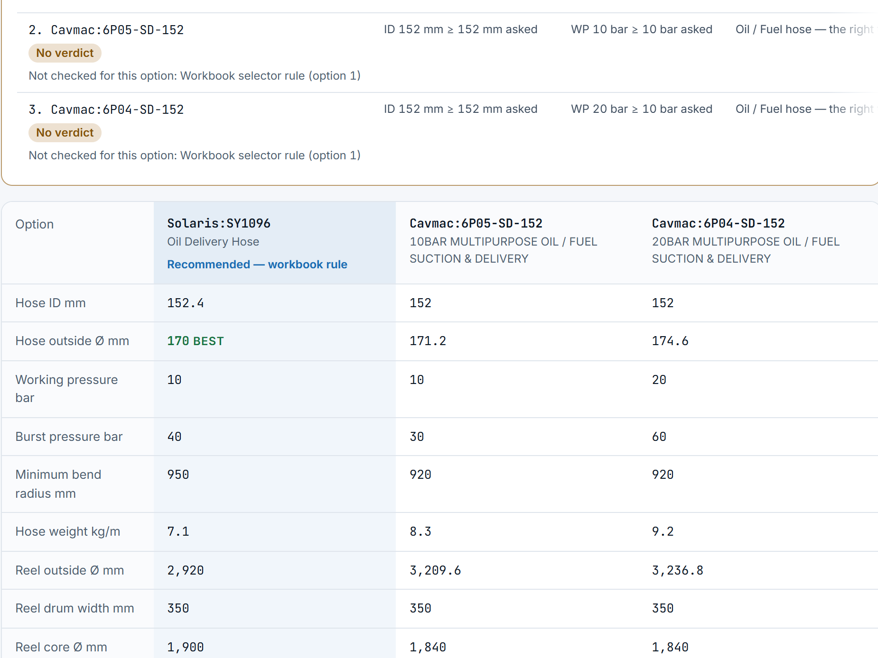
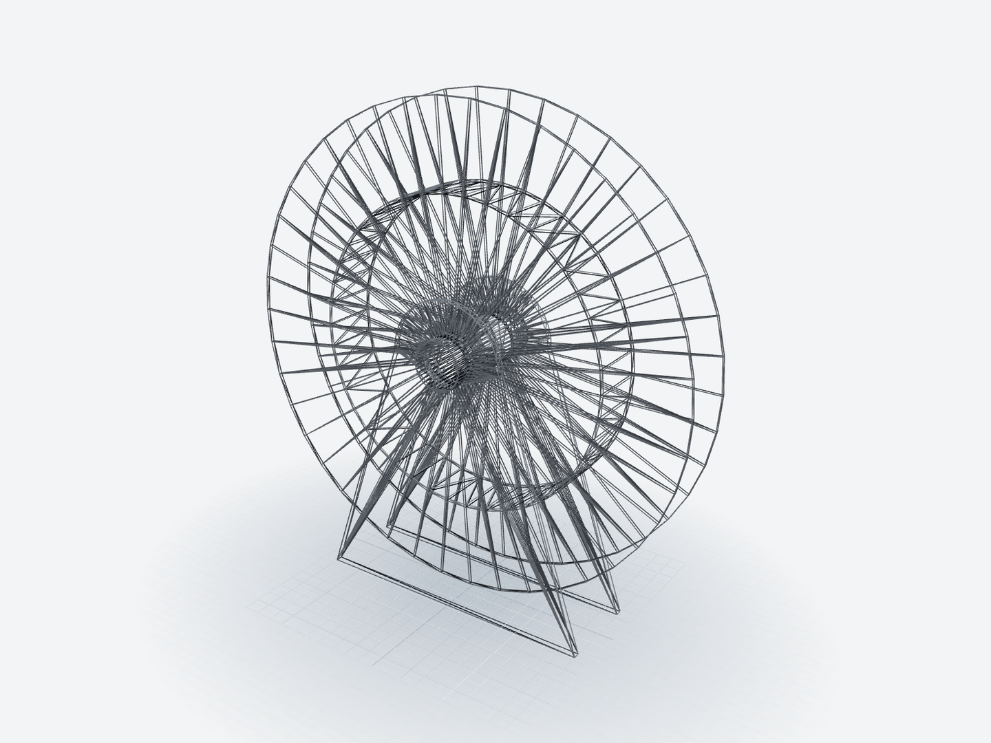
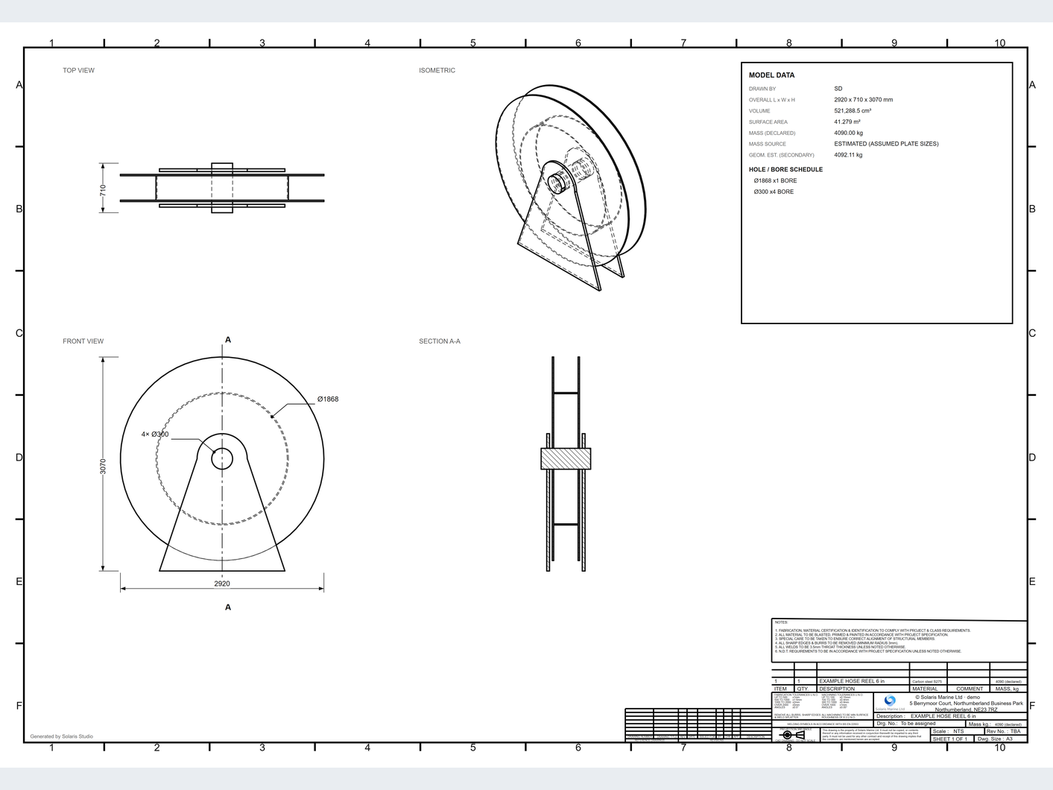
From a client's enquiry to a calculated, designed and documented job
INVICTUS CAD
Every number shows where it came from. The engineer decides.
1
CLIENT BRIEF
read from the enquiry
2
CALCULATIONS
hose, reel, flotation, string
3
3D MODEL
a parametric solid
4
GA DRAWING
PDF, DXF and STEP
Solaris Marine – Invictus CAD
Screens: demo account, fictional data 3

Slide 4
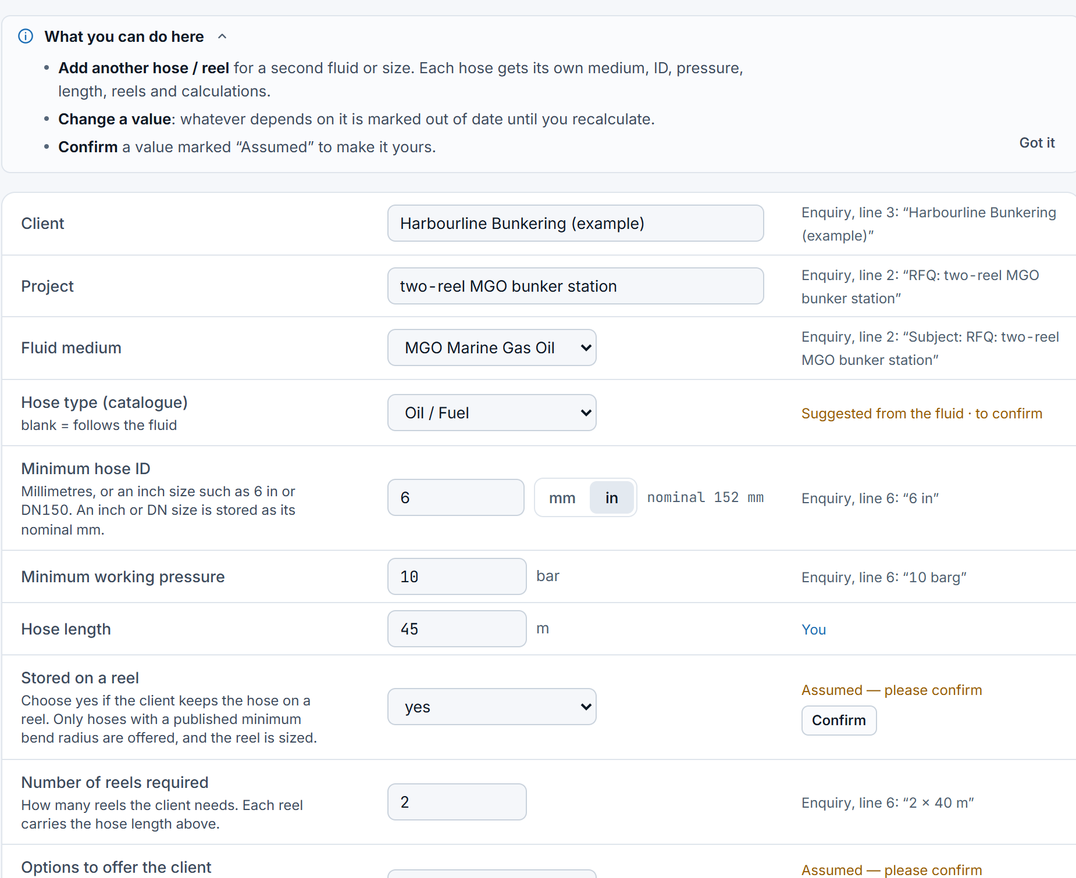
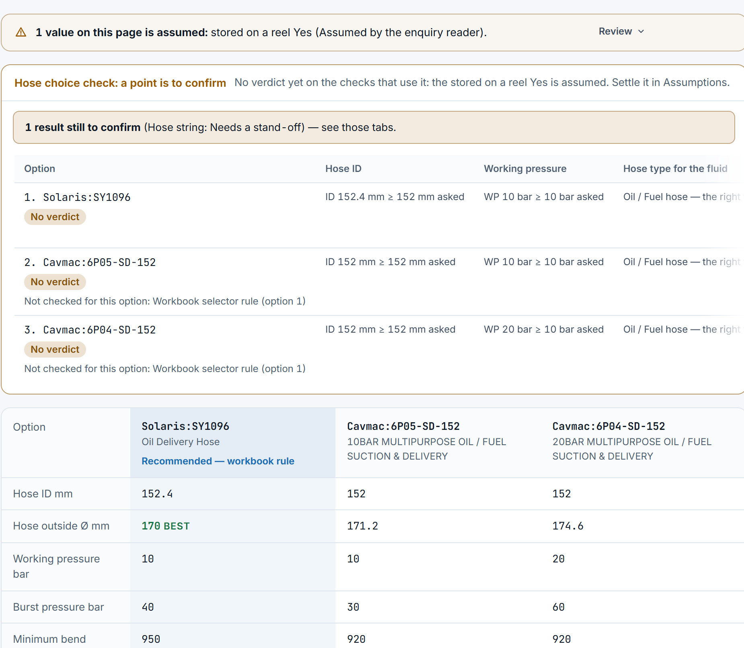
From enquiry to engineered job
JOBS
LIVE TODAY
1
Read the enquiry
Paste it, or drop the PDF, Word, Excel or email. Each value keeps its source.
2
Solve the brief
Hose options, reel, flotation and hose string, all worked from the brief.
3
Confirm assumptions
Assumed values say 'please confirm'. Blanks are asked for, never filled in.
CLIENT BRIEF · VALUES WITH SOURCES
HOSE OPTIONS · SAME JOB
Solaris Marine – Invictus CAD
Screens: demo account, fictional data 4

Slide 5
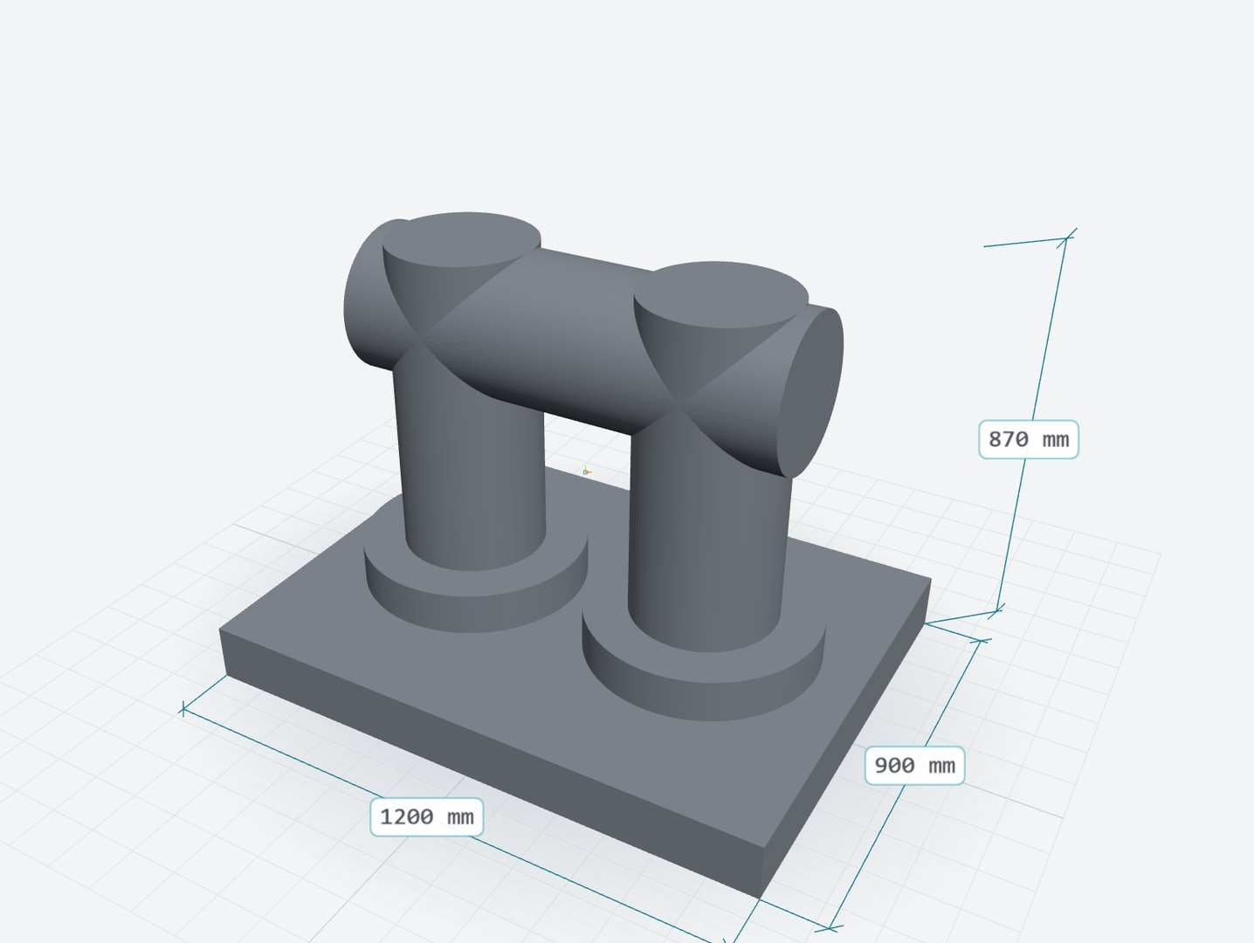
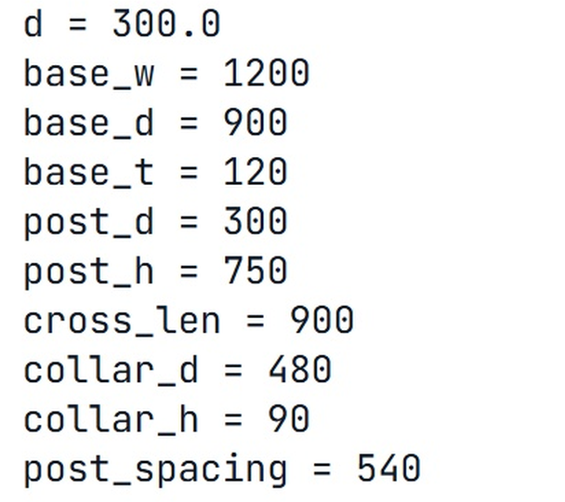
From a description to a 3D solid
DESIGN · 3D MODEL
LIVE TODAY
1
Start from the job, or describe it
Send the job's solved numbers, or describe a known part family in the Design chat.
2
A real solid, not a picture
Size and mass come from the geometry.
3
Every dimension is named
Change one, then Save and rebuild.
SOURCE CODE · NAMED PARAMETERS
Solaris Marine – Invictus CAD
Screens: demo account, fictional data 5

Slide 6
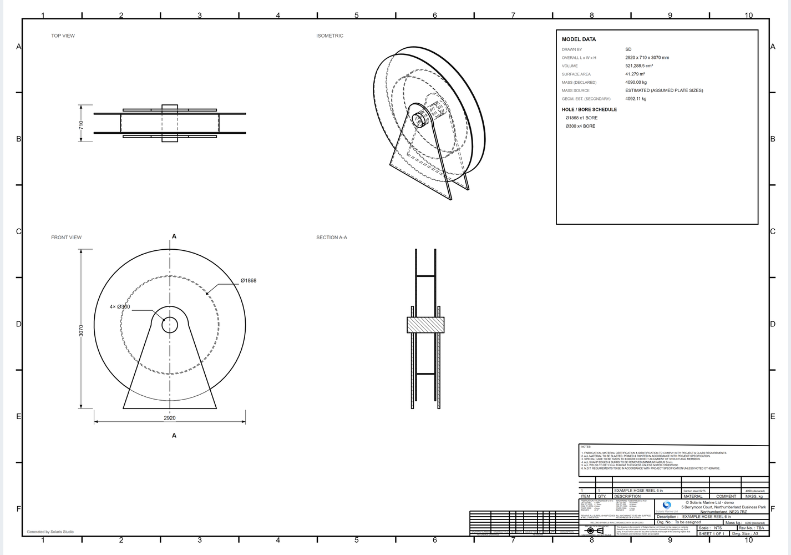
A BS 8888-style GA drawing
DESIGN · DRAWING
LIVE TODAY
From the same model: plan, front and section views, hole and bore schedule, model data, title block.
DOWNLOAD
PDF
DXF
STEP
MASS, WITH ITS BASIS
4,090 kg
Estimated on assumed plate sizes
Carbon steel S275
The flanges are simplified solid plates, so Studio flags the mass as overstated.
Solaris Marine – Invictus CAD
Screens: demo account, fictional data 6

Slide 7
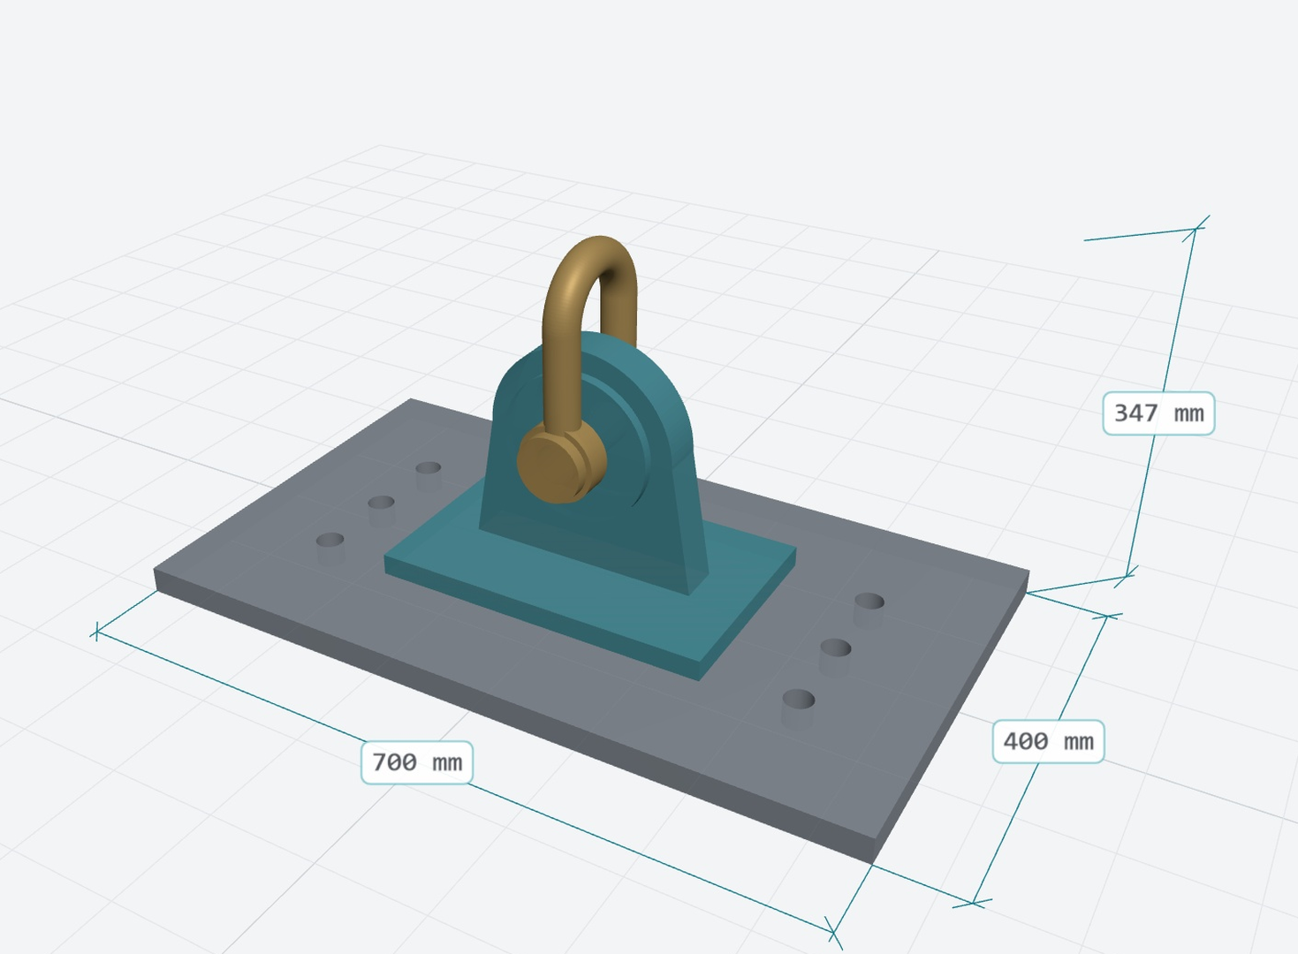
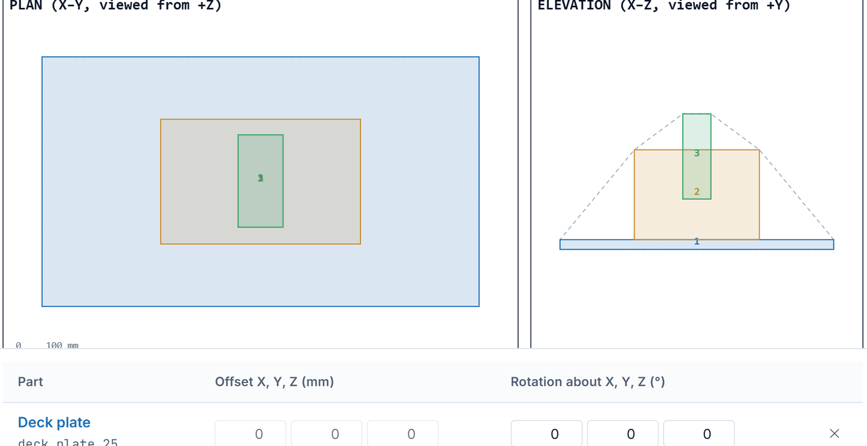
Assemblies with clash checks
DESIGN · ASSEMBLIES
LIVE TODAY
LIFTING POINT 36 MM · 3 PARTS IN 3D
ARRANGEMENT DRAWING · PLAN AND ELEVATION
1
Placed together
Real solids, each in its own colour.
2
Arrangement
Plan, elevation, offsets and rotations.
3
Clash check
Solid against solid, not box against box.
4
One package
Every deliverable in one download.
Solaris Marine – Invictus CAD
Screens: demo account, fictional data 7

Slide 8
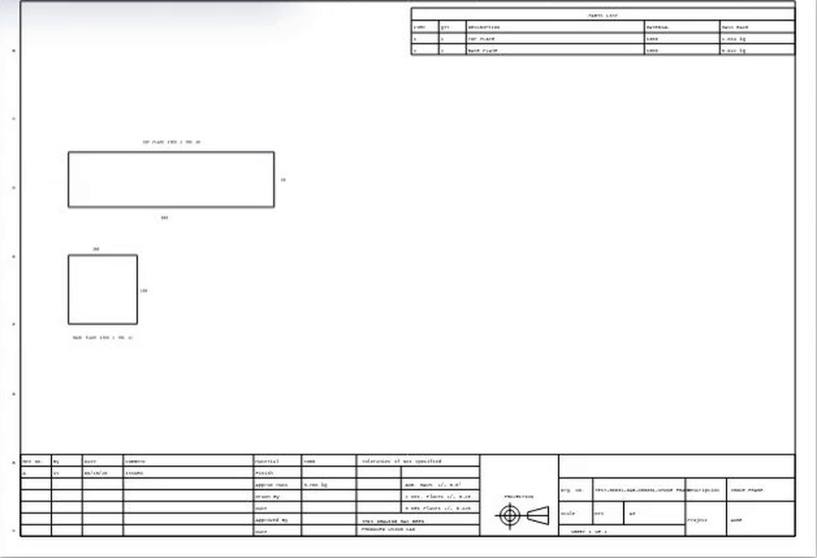
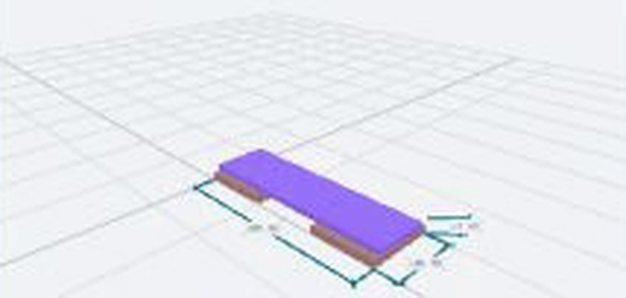
Checked against the engineer's drawing
DESIGN · DRAWING CHECKS
LIVE TODAY
An engineer's drawing from Documents, checked against the part Studio built from it.
INVICTUS CAD BUILD, IN 3D
MASS CHECK
Drawing
CAD build
Difference
3.77 kg
3.77 kg
0.0 %
Findings split three ways: for the drafter, for the Studio build, and what needs more information.
ENGINEER'S DRAWING · ORIGINAL PDF, REV A
Solaris Marine – Invictus CAD
Screens: demo account, fictional data 8

Slide 9
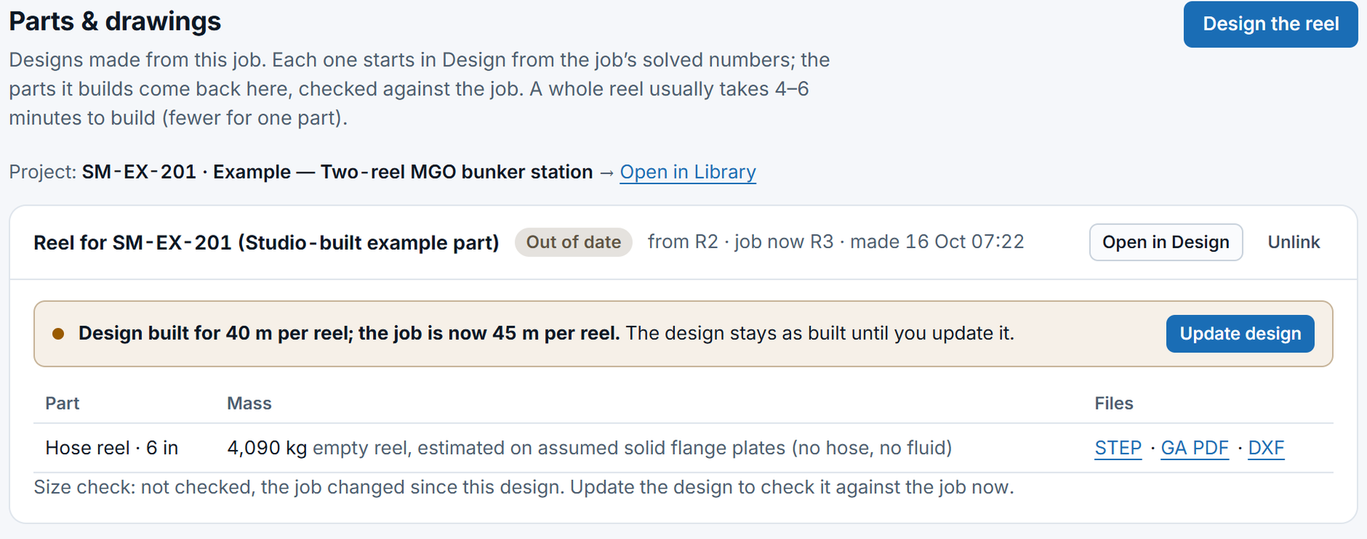
Designs follow the job
DESIGN · FROM THE JOB
LIVE TODAY
1
Design the reel
The job's solved numbers go straight to Design.
2
Flagged, never overwritten
Change the job and the design says so.
3
Update design
Rebuild when you are ready: STEP, GA PDF and DXF.
Solaris Marine – Invictus CAD
Screens: demo account, fictional data 9

Slide 10
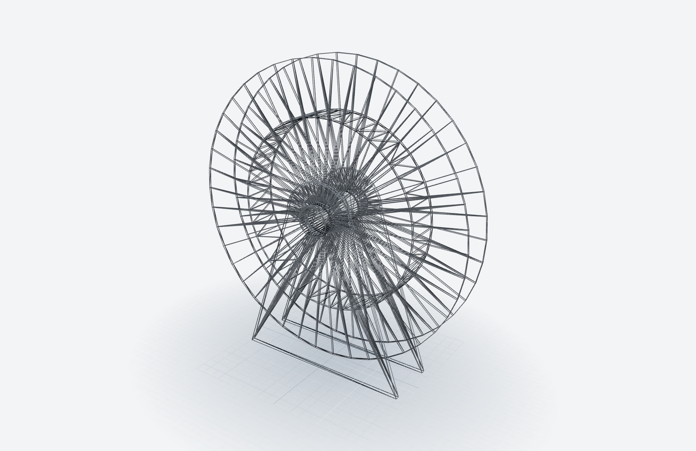
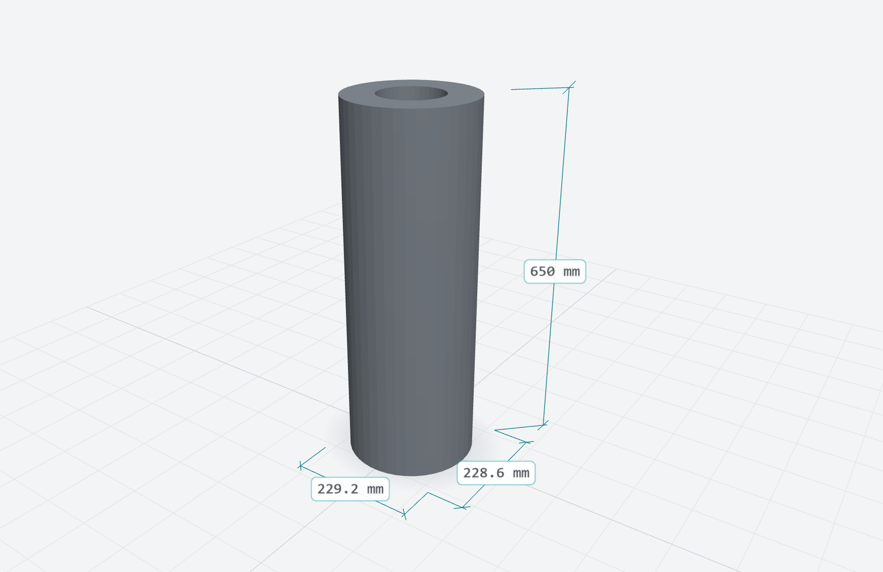
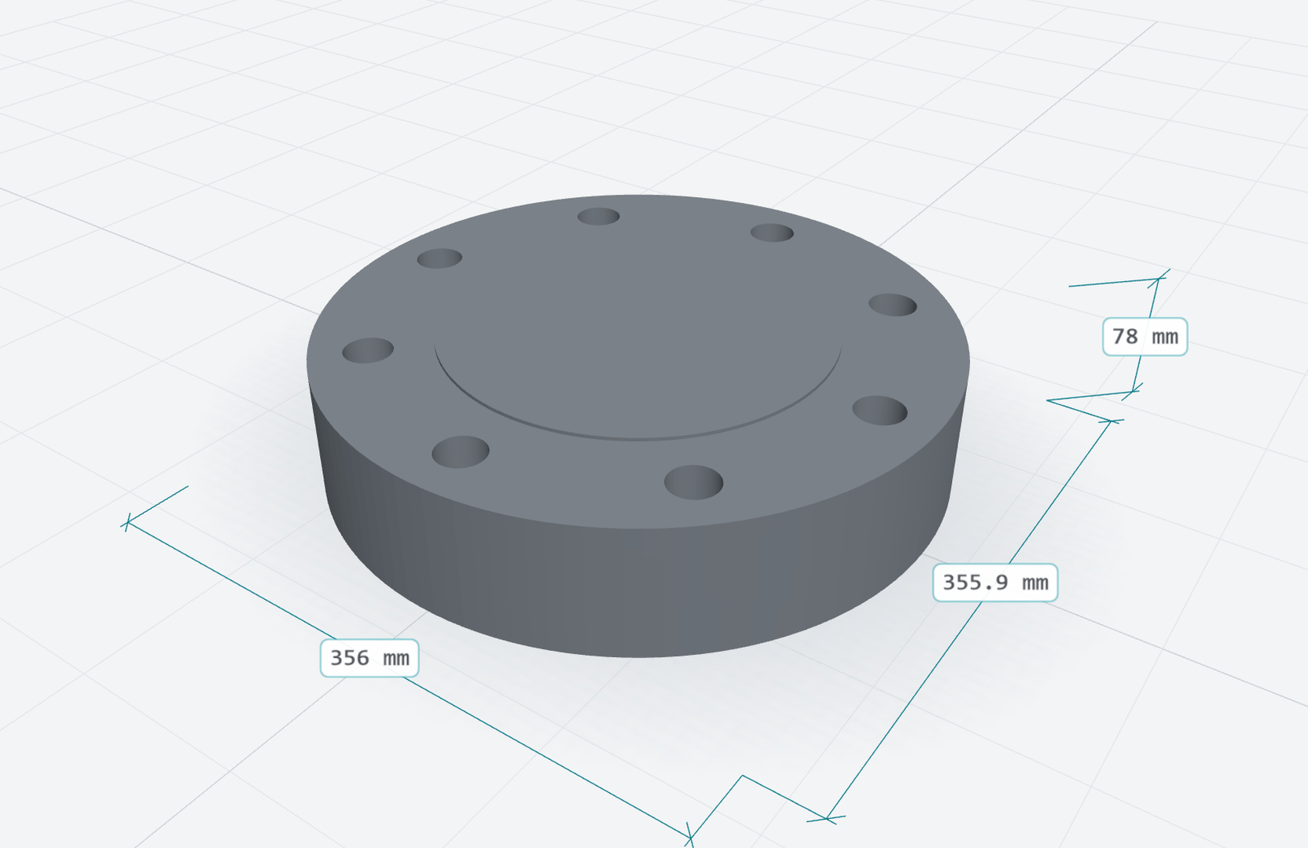
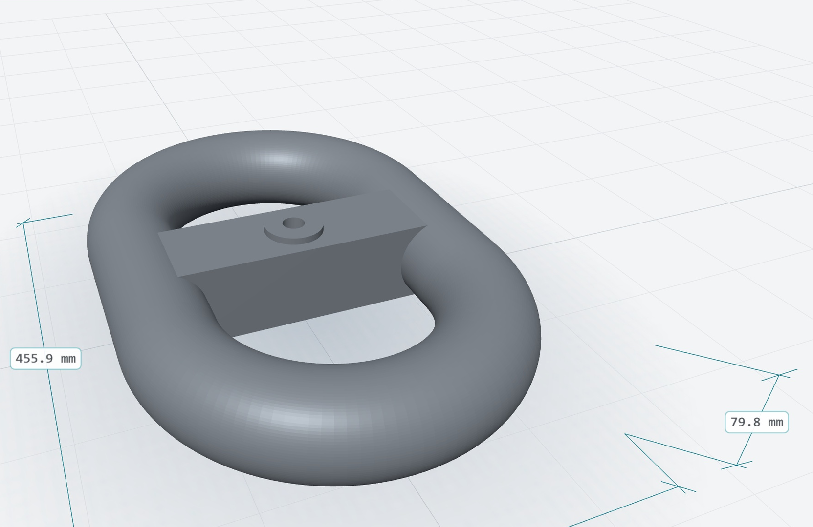
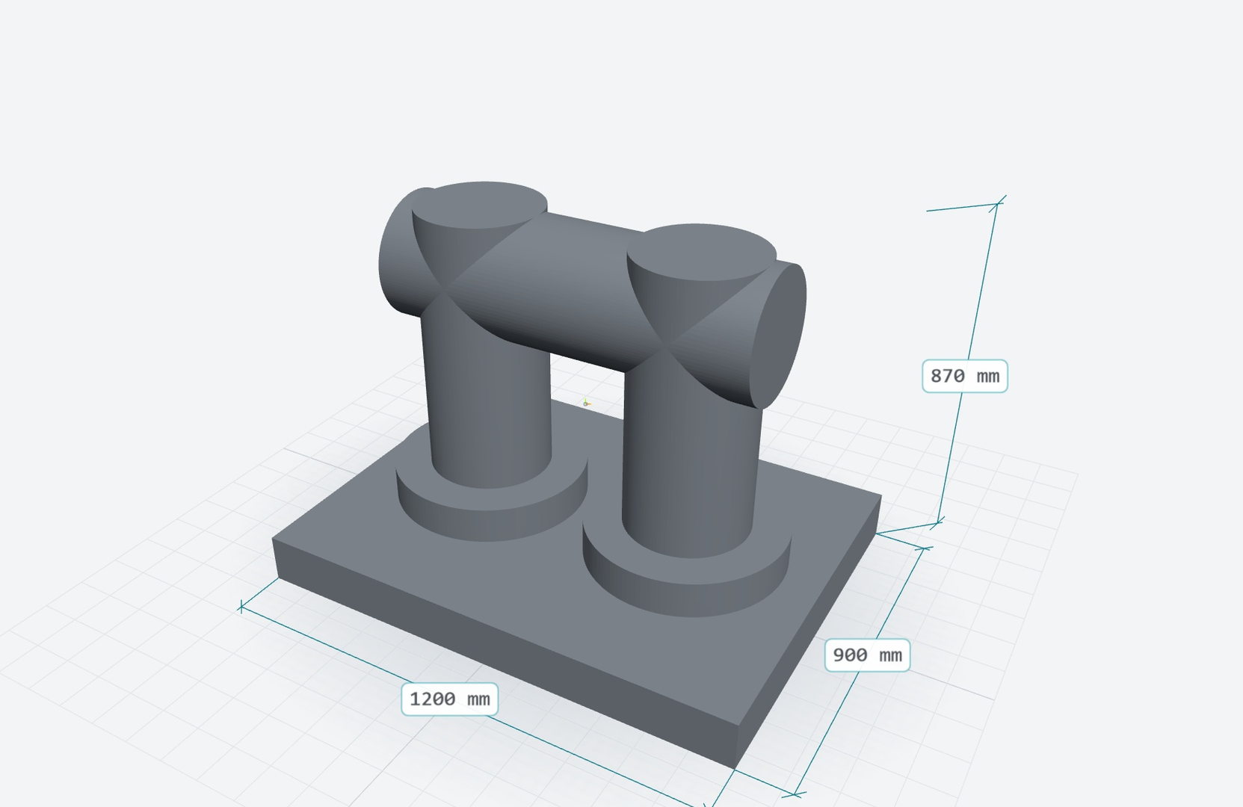
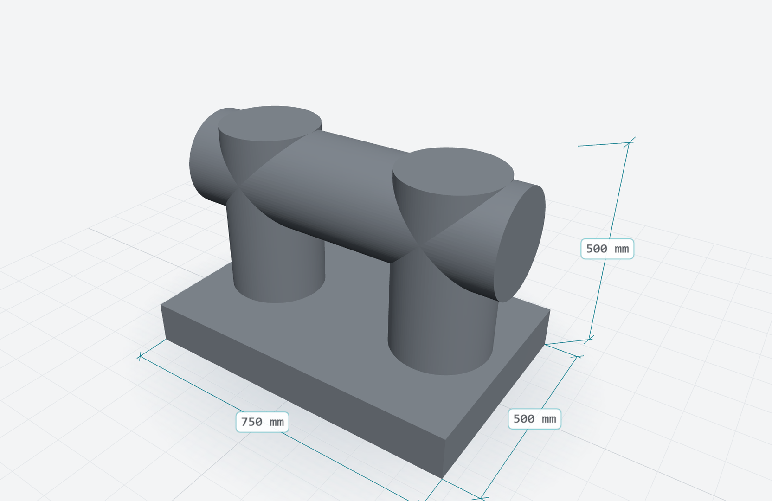
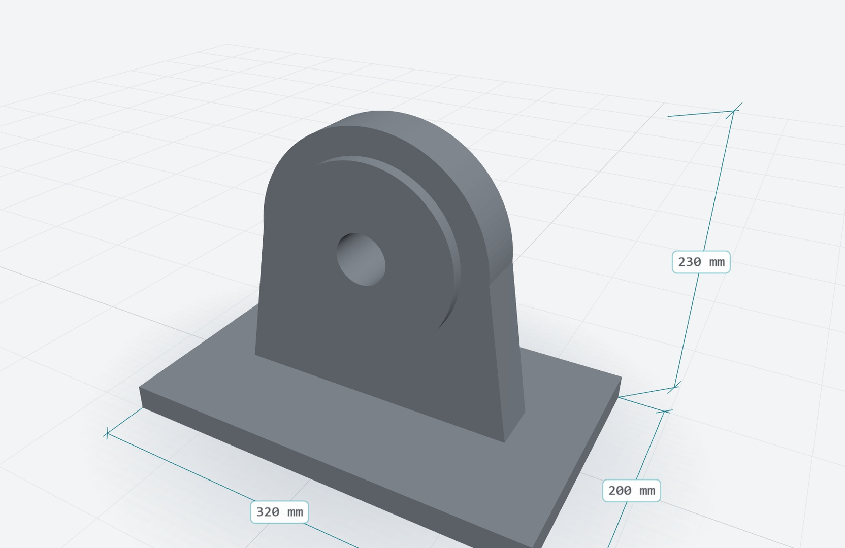
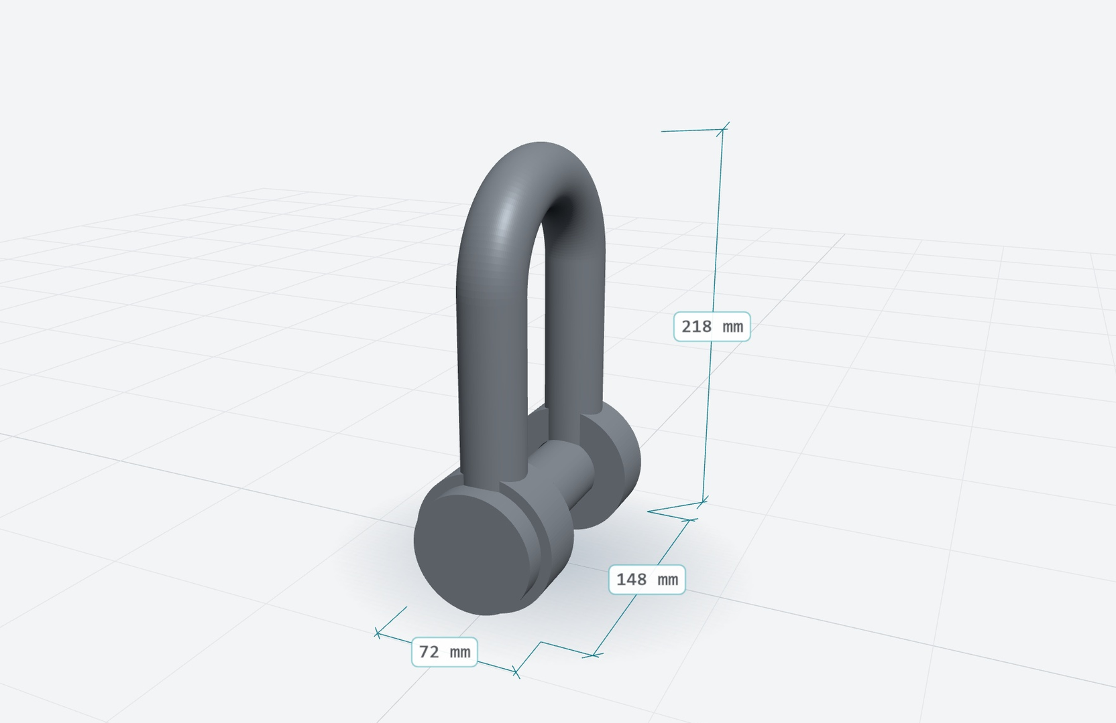
One library of parts
LIBRARY
LIVE TODAY
Hose reel, 6 in
4,090 kg · S275
Mass: estimate
Float collar, 4 in
19.06 kg · HDPE
Mass: on the drawing
API 6A flange, 6 in
58.35 kg · SS316
Mass: estimate
Kenter shackle, 76 mm
43.54 kg · carbon steel
Mass: estimate
Bollard, 300 mm
2,264.76 kg · SS316
Mass: estimate
Deck cleat, 250 mm
671.53 kg · SS316
Mass: estimate
Pad eye, 36 mm
23.43 kg · S355
Mass: estimate
Shackle, 36 mm
4.74 kg · carbon steel
Mass: estimate
Solaris Marine – Invictus CAD
Screens: demo account, fictional data 10

Slide 11
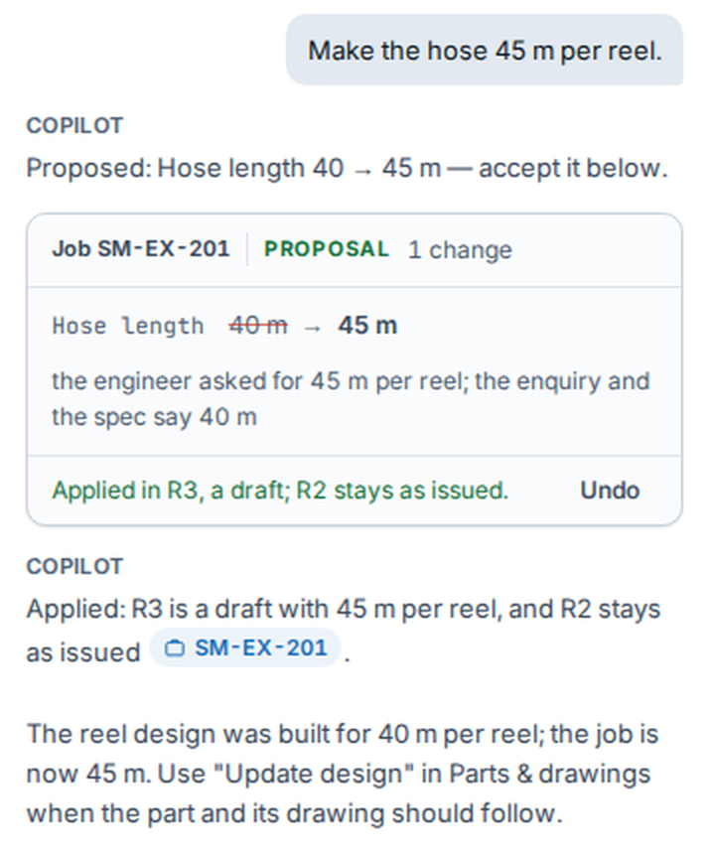
The Copilot proposes. You decide.
COPILOT
LIVE TODAY
1
A proposal, never a silent edit
A change comes back as a card: the old value, the new one and why. Nothing changes until you Apply. Undo puts it back.
2
Answers from the job, with sources
It works from the job's own data. Each figure carries a source; click it and that page opens.
3
Says what it could not find
Missing values are marked 'check' and asked for, never assumed.
Solaris Marine – Invictus CAD
Screens: demo account, fictional data 11

Slide 12
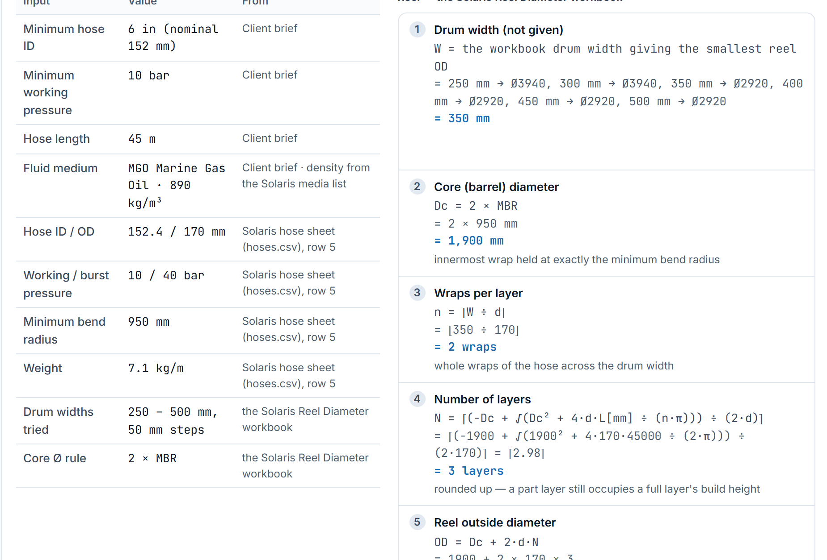
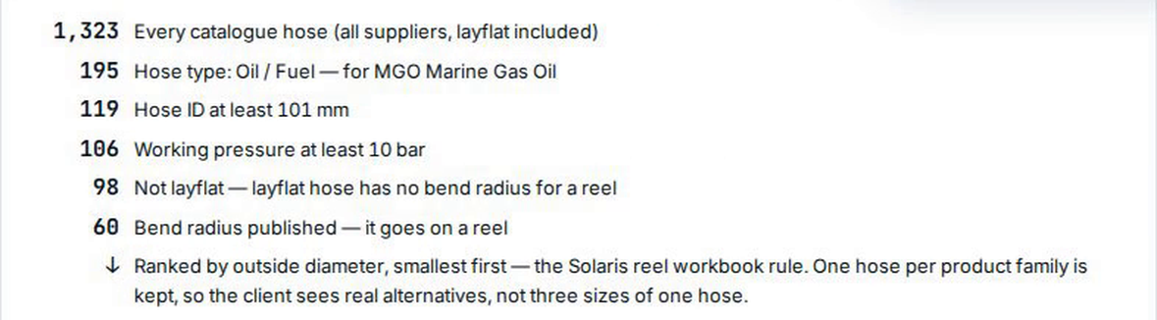
Every number shows its working
ENGINEERING
LIVE TODAY
REEL · EVERY INPUT WITH ITS SOURCE, EVERY STEP
HOSE OPTIONS · HOW THE OPTIONS WERE REACHED
THE RULES
Every input shows its source.
Blanks are asked for, never assumed.
A check passes only when the check itself passes.
Solaris Marine – Invictus CAD
Screens: demo account, fictional data 12

Slide 13
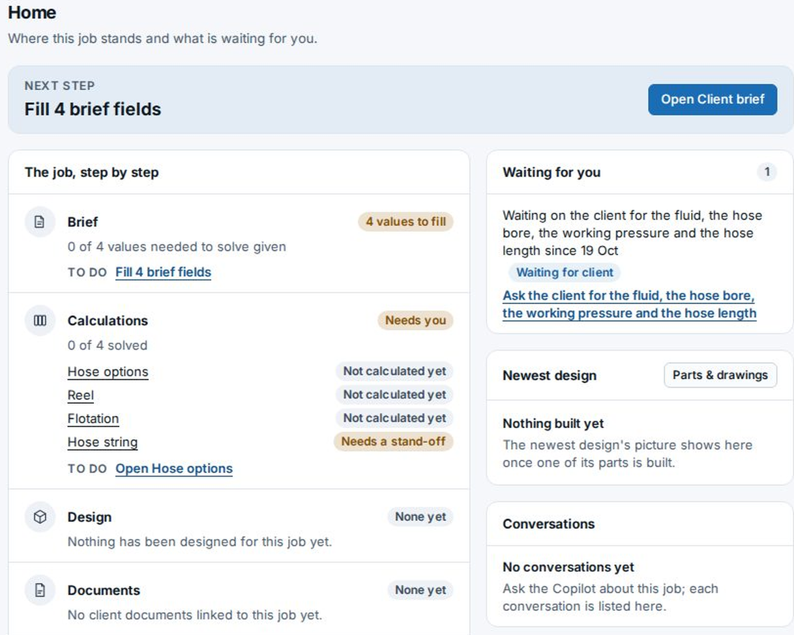
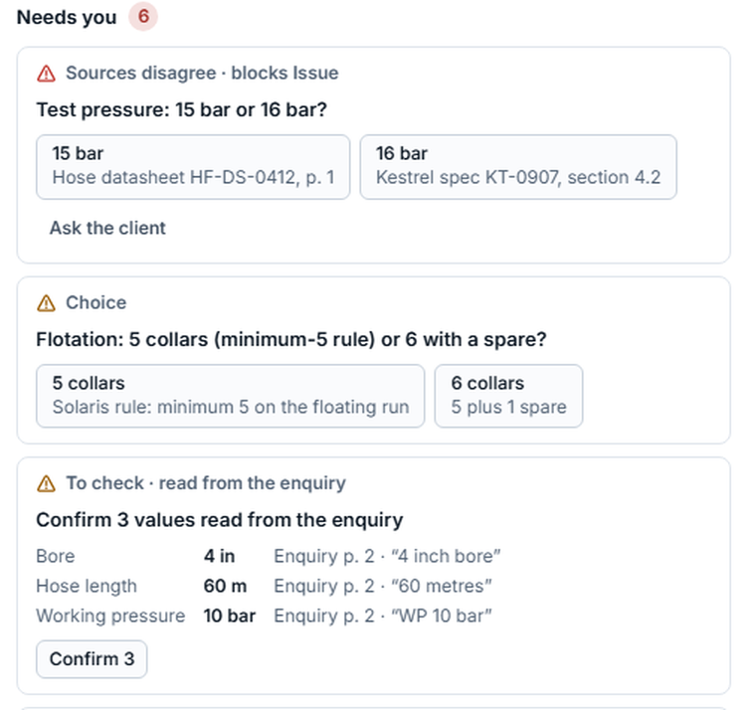
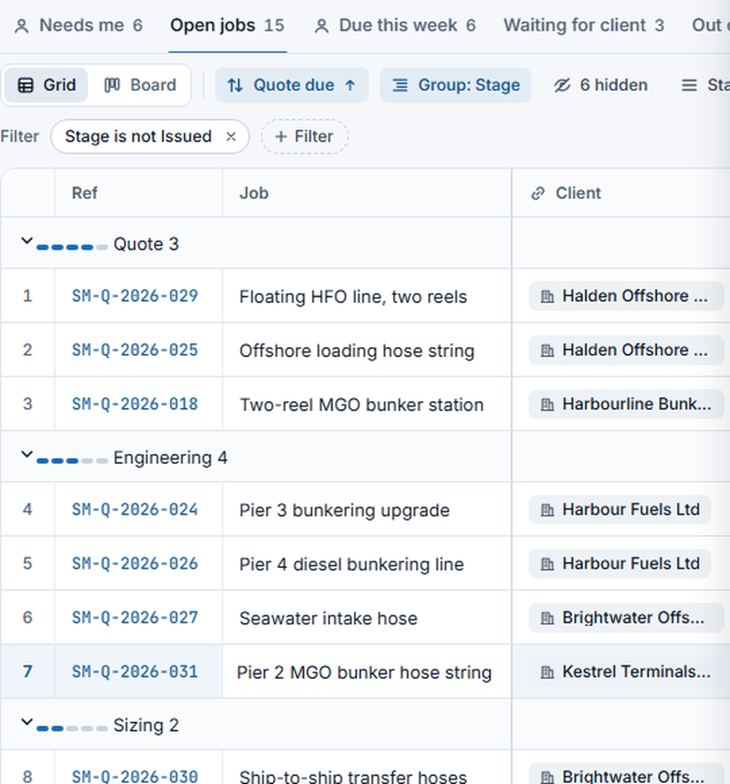
New ways to run the work
COMING NEXT
NOT LIVE YET
Project Home
One page per job: the next step, each stage's state, and what is waiting for you.
BUILT · IN TRIAL
NOT SWITCHED ON YET
Needs you
Every open decision on a job, with both sources side by side. You choose.
PROTOTYPE · FICTIONAL DATA
Jobs list as a grid
Grid, board and saved views, grouped by stage.
BUILT · IN TRIAL
PICTURE: DESIGN PROTOTYPE
Solaris Marine – Invictus CAD
Demo and prototype screens, fictional data 13

Slide 14
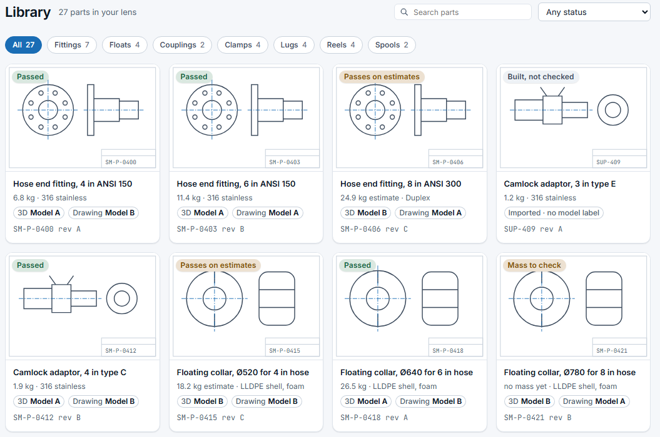
Live now, and coming next
DESIGN AND DRAWINGS
1
The Copilot designs new parts
LIVE TODAY
Describe a part in words. It lists the design basis it needs, such as the standard, loads and weld sizes, and never fills it in itself. You choose the values; it builds the 3D model, the drawing and its own checks.
Try it at the stand.
COMING NEXT · NOT LIVE YET
2
The Library as views
Grid, board and saved views for parts, with each part's status.
3
Drawing register
Drawing revisions, a register and transmittals.
PROTOTYPE · FICTIONAL DATA
Solaris Marine – Invictus CAD
Prototype screen, fictional data 14

Slide 15

Join the early-access list
SOLARIS MARINE
See Invictus CAD work on your own hose systems.
Videos and early access
solarismarine.co.uk/studio
Solaris Marine – Invictus CAD
solarismarine.co.uk

